Slide 1
The True Meaning of “Decision Day”
Edward Gates, Jr.
Philip Nunoo
Nikita Jones
Mason Waters

Slide 2
Agenda
Introduction
The Why?
Data Exploration & Clean-Up
Analysis
Undergraduate Major
Region
School Type
Conclusion

Slide 3
Introduction
We are seeking to discredit the perception that higher tuition results in higher salaries in our careers.
Our project will attempt to analyze and compare the starting, mid-career, and mid-career 90th percentile salaries:
Undergraduate majors, Regions, School Types
Questions
For higher income :
What should my major be?
Which region should I attend college?
What type of college should I attend?

Slide 4
THE WHY?
Thinking face
Decision Day!

Slide 5
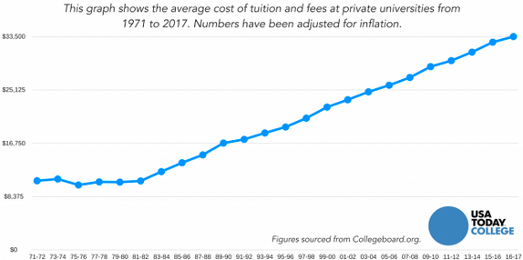
Average Cost of Tuition and Fees
270%

Slide 6
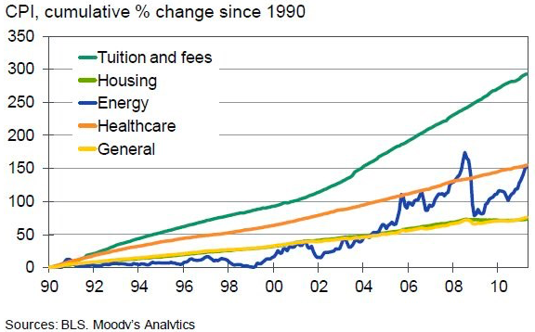
Tuition & Fees vs. Other Indices

Slide 7
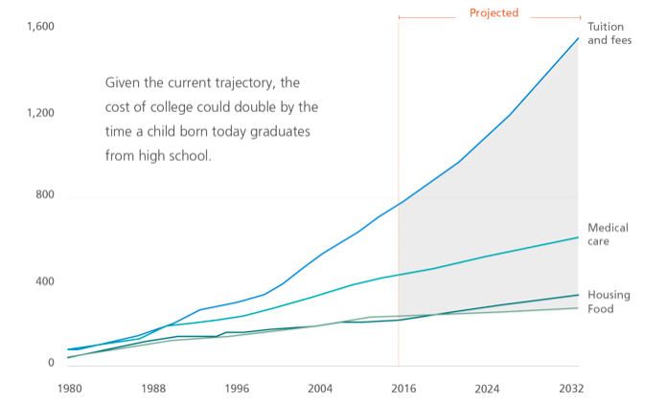
Tuition & Fees vs. Other Indices

Slide 8
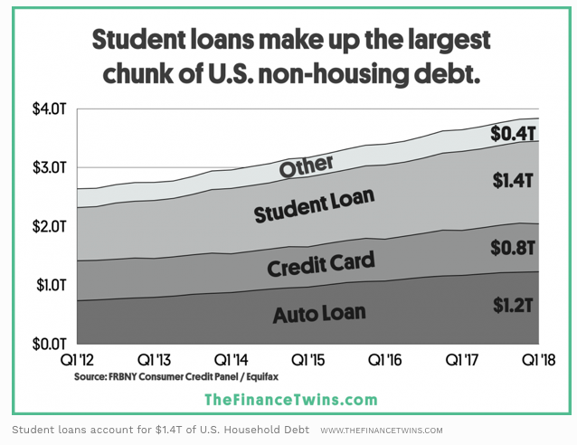
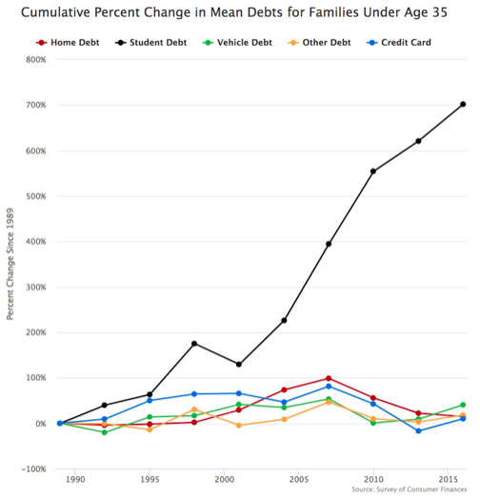
Student loans vs U.S Non-Housing Debt
40%

Slide 9
Data Exploration & Clean-Up
Some image
Decision Day!

Slide 10
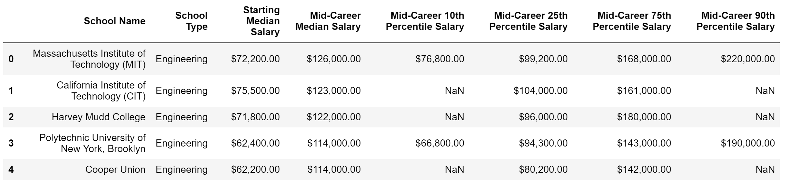
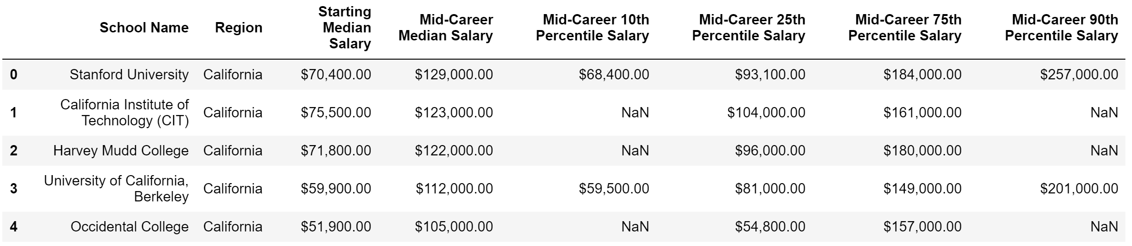
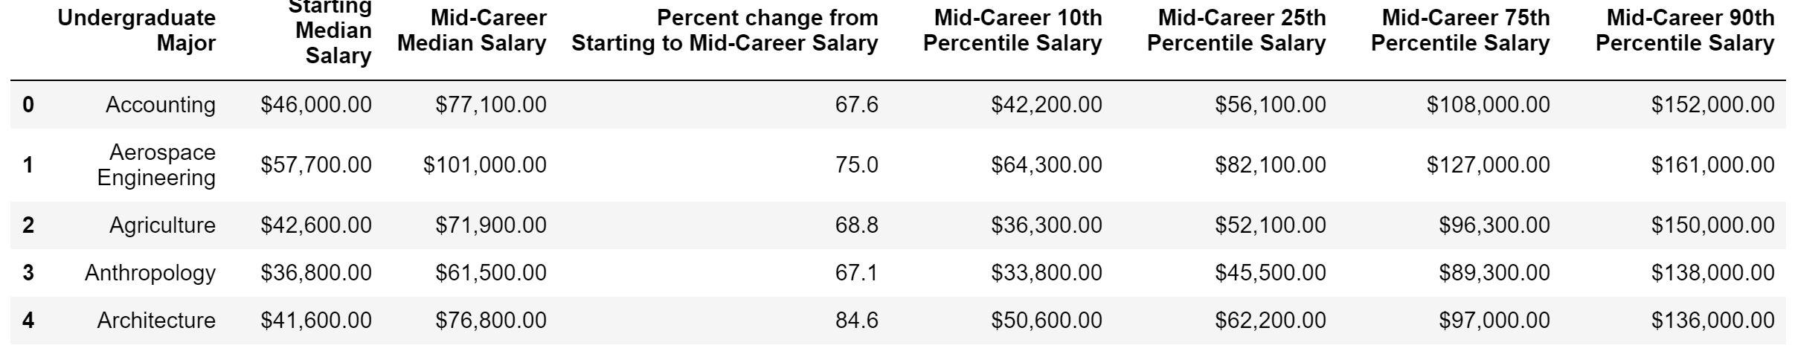
Data Exploration & Clean-Up
School Type
Region
Major

Slide 11
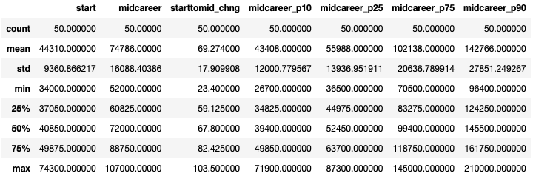
Overall Descriptive Statistics – Undergraduate Major

Slide 12
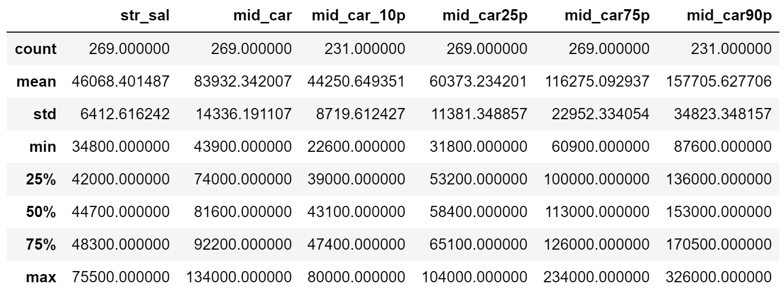
Overall Descriptive Statistics – School Type

Slide 13
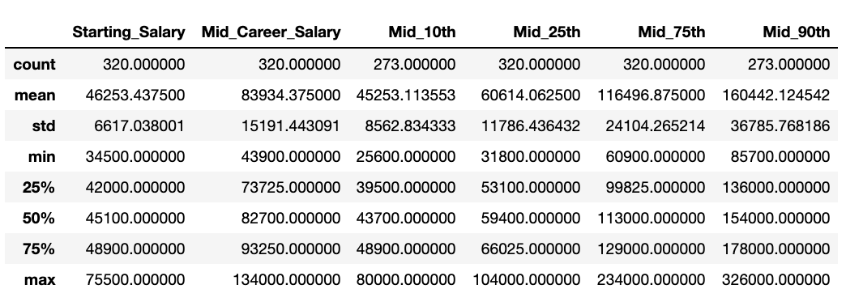
Overall Descriptive Statistics – Region

Slide 14
Data Analysis: major
Some image
Decision Day!

Slide 15
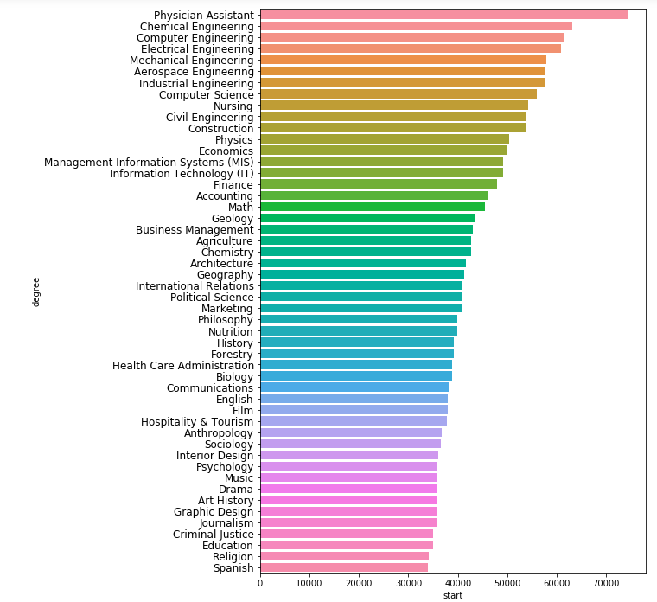
Which Undergraduate Majors get the highest income at the start of their careers?
Top 5
Physician Assistant: $74,300
Chemical Engineering: $63,200
Computer Engineering: $61,400
Electrical Engineering: $60,900
Mechanical Engineering: $57,900
Bottom 5
Spanish: $34,000
Religion: $34,100
Education: $34,900
Criminal Justice: $35,000
Journalism: $35,600

Slide 16
Which Undergraduate Majors get the highest income at Mid-Career?
Top 5
Chemical Engineering: $107,000
Computer Engineering: $105,000
Electrical Engineering: $103,000
Aerospace Engineering: $101,000
Economics: $98,600
Bottom 5
Religion: $52,000
Education: $52,000
Spanish: $53,100
Interior Design: $53,200
Music: $55,000

Slide 17
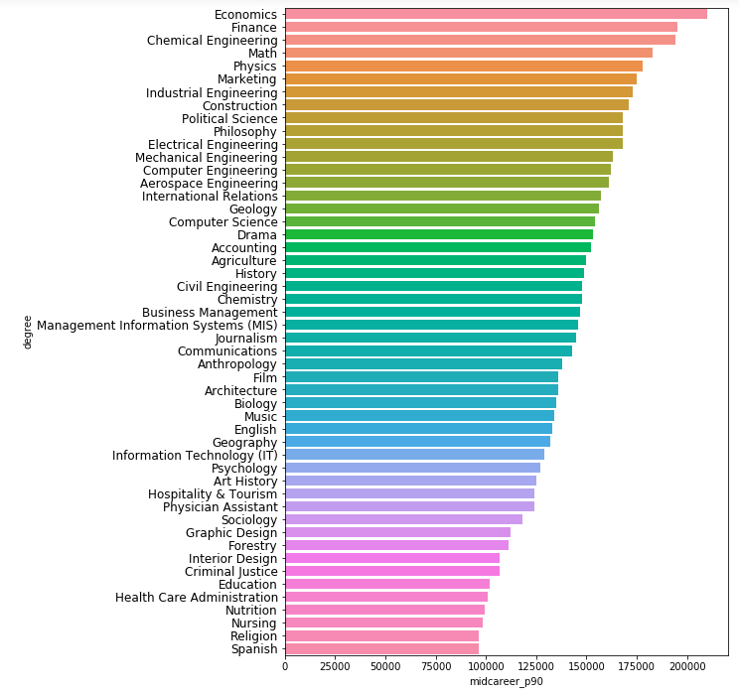
Which Undergraduate Majors get the highest income at Mid-Career 90th Percentile?
Top 5
Economics: $210,000
Finance: $195,000
Chemical Engineering: $194,000
Math: $183,000
Physics: $178,000
Bottom 5
Spanish: $96,400
Religion: $96,400
Nursing: $98,300
Nutrition: $99,200
Healthcare Administration: $101,000

Slide 18
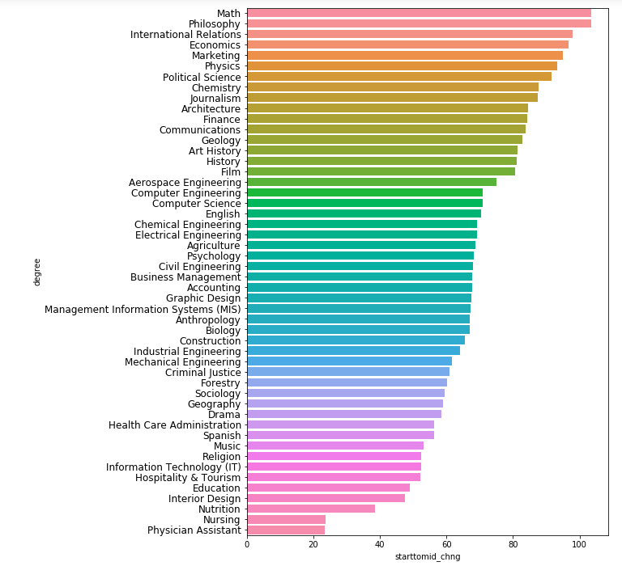
Percent change from Starting to Mid-Career Salary
Top 5
Math: 103.5%
Philosophy: 103.5%
Economics: 97.8%
Marketing: 96.8%
Physics: 95.1%
Bottom 5
Physician Assistant: 23.4%
Nursing: 23.4%
Nutrition: 38.6%
Interior Design: 47.4%
Education: 49%

Slide 19
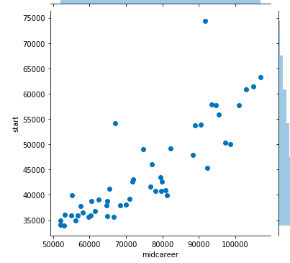
Starting vs. Mid-Career Median Salary
Physician Asst
Pearson Correlation: 0.85

Slide 20
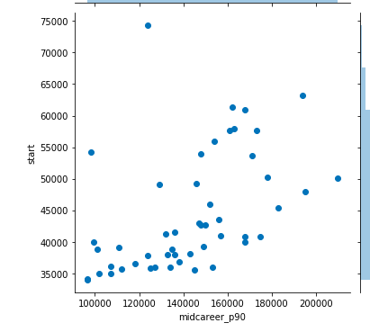
Starting vs. Mid-Career 90th Percentile Median Salary
Pearson Correlation: 0.70

Slide 21
Degree Majors Summary
Physician Assistants start their career noticeably with the best salary.
In the middle of the career, Chemical Engineers and then Computer Engineers get the best salary.
In the long term, Economists have the salary advantages who earns the best salary when compared to others.
Mathematicians and Philosophers have the most increase in their salary during their career.
As a result of analyzes we have made, different jobs have different advantages in their career opportunities when start salary, long term salary and increase in salary percentage compared.

Slide 22
Data Analysis: REGION
Some image
Decision Day!

Slide 23
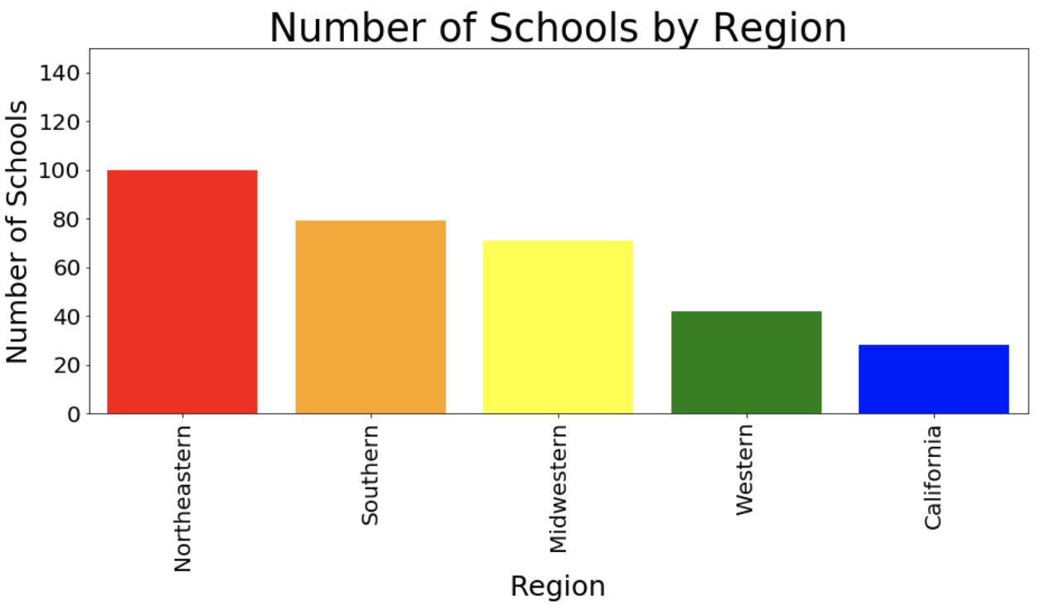
Number of Schools Per Region

Slide 24
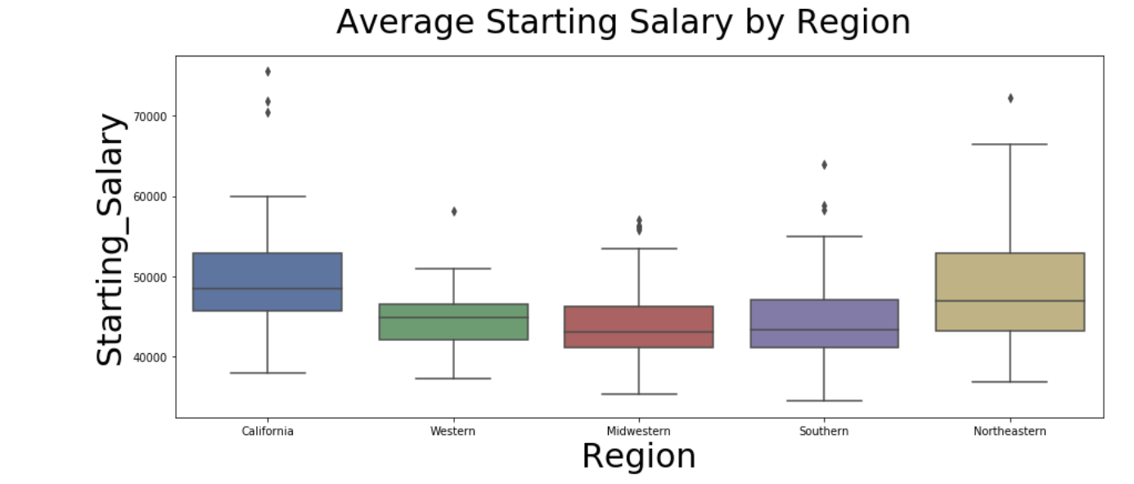
Median Starting Salary

Slide 25
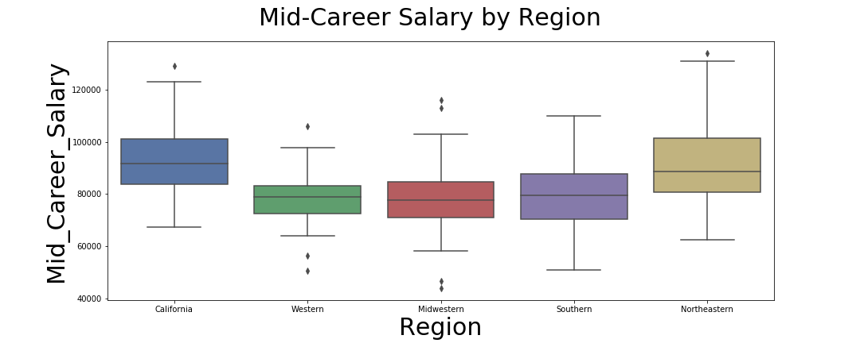
Mid-Career Salary

Slide 26
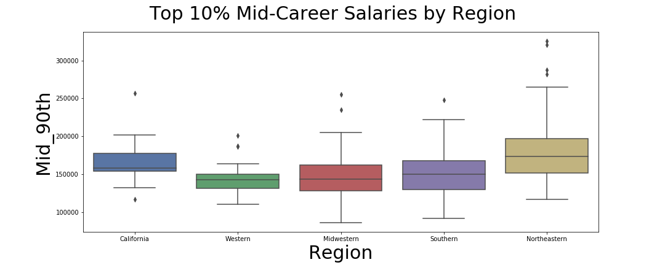
Top 10% Mid-Career Salaries

Slide 27
Data Analysis: SCHOOL TYPE
Some image
Decision Day!

Slide 28
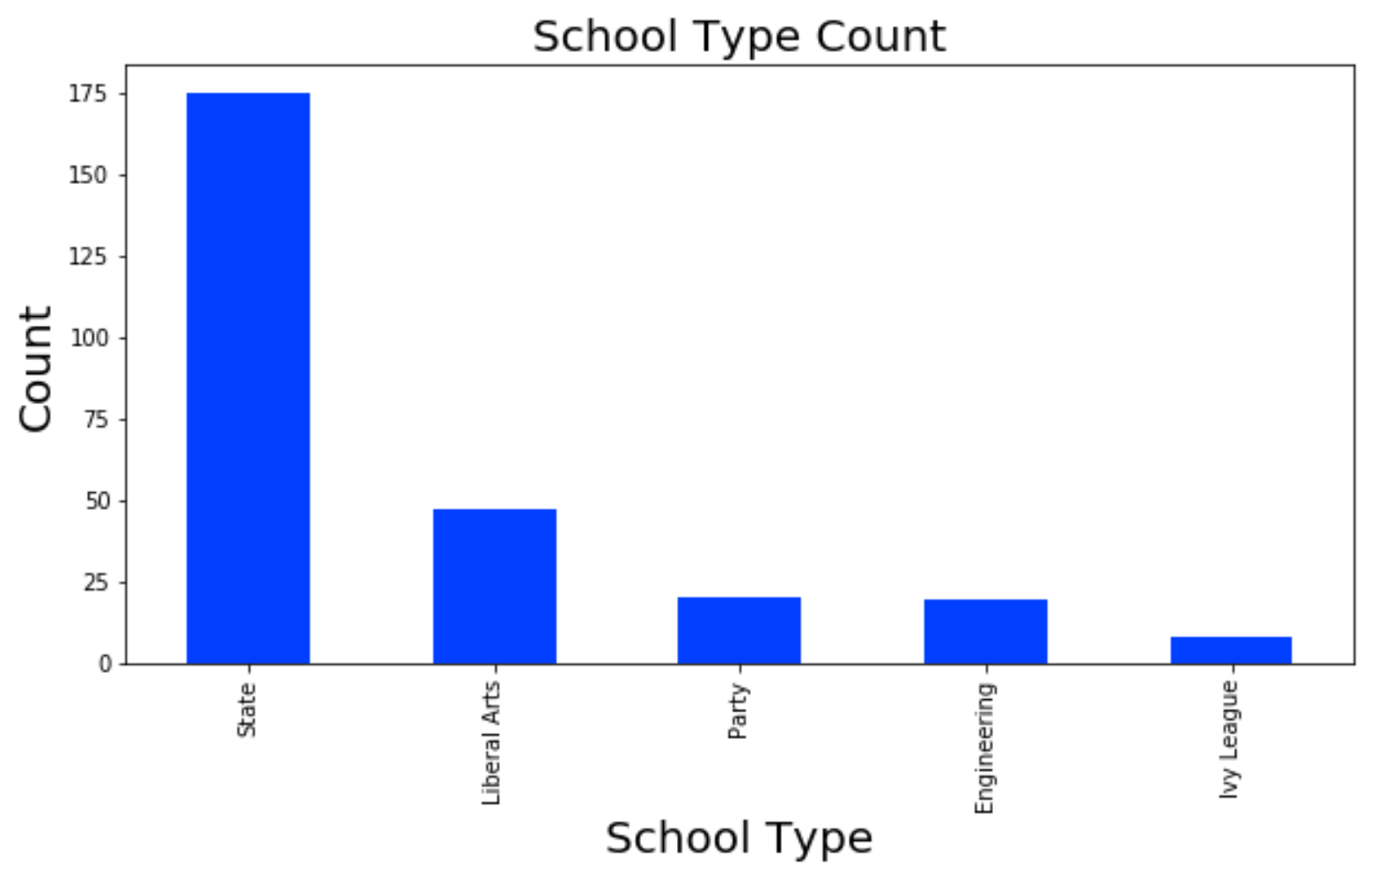
Number of Schools Per School Type

Slide 29
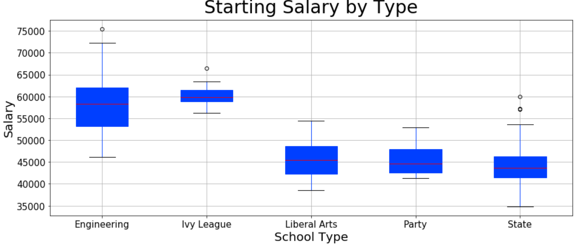
Distribution of Starting Salary by School Type

Slide 30
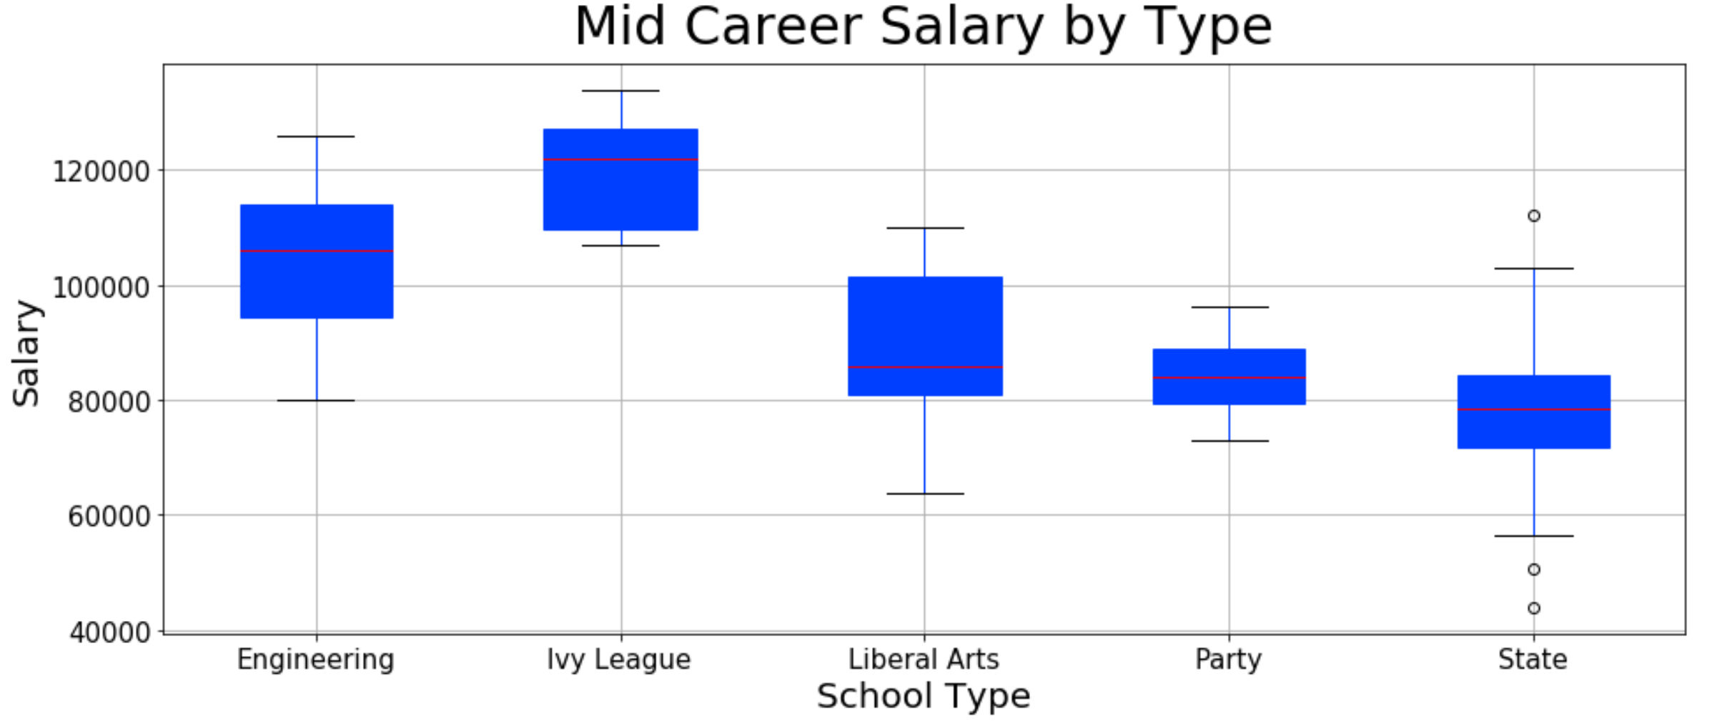
Distribution of Mid-Career Salary by School Type

Slide 31
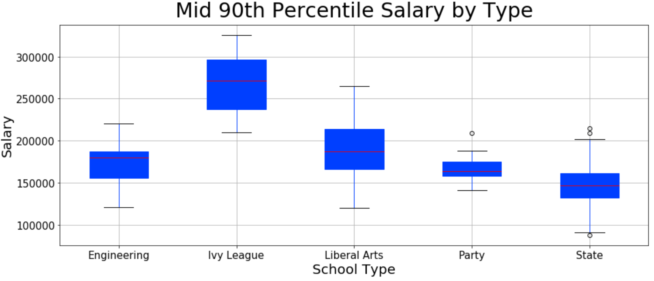
Distribution of Mid-Career 90th Salary by School Type

Slide 32

THE WHY?
Decision Day!

Slide 33

Data Exploration & Clean-Up
Decision Day!

Slide 34

Data Analysis: major
Decision Day!

Slide 35
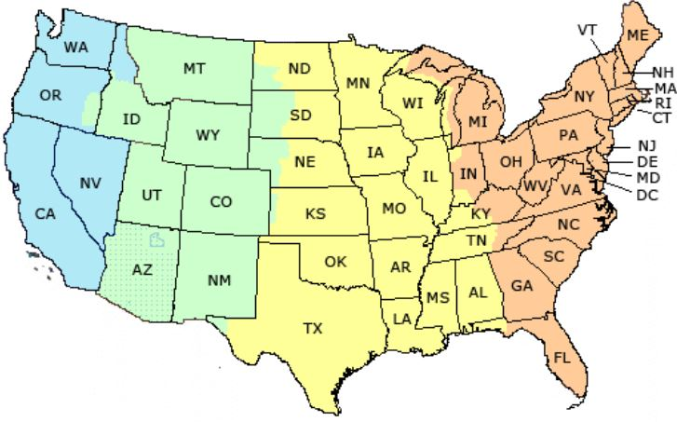
Data Analysis: REGION
Decision Day!

Slide 36



Data Analysis: SCHOOL TYPE
Decision Day!

Slide 37
?
Any questions?
?
?

